Slide 1
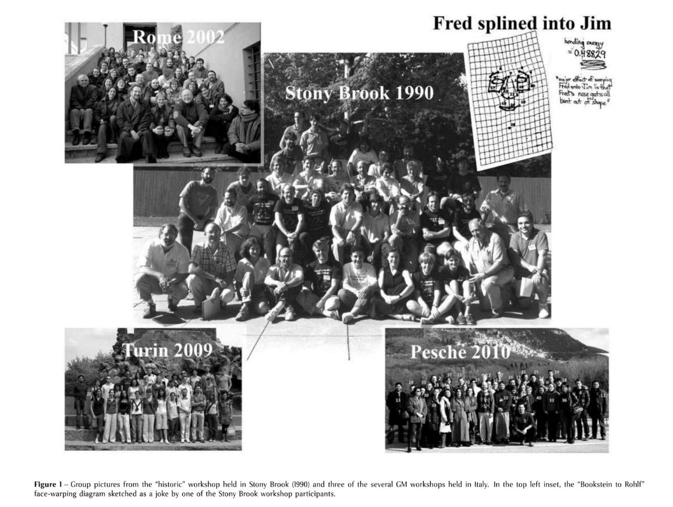

Slide 2
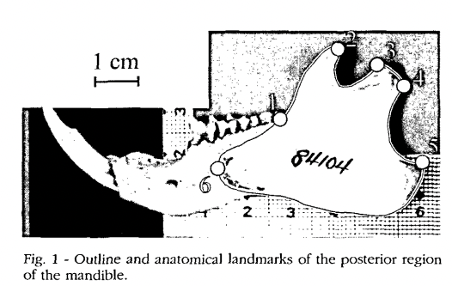
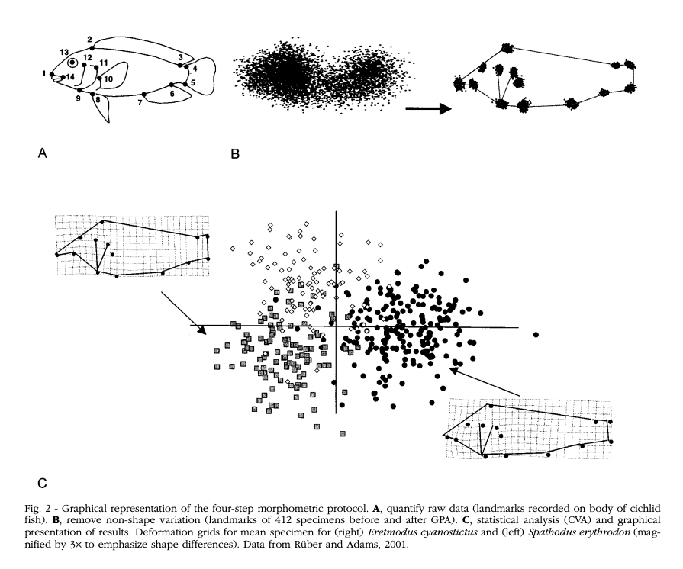
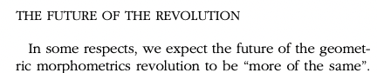
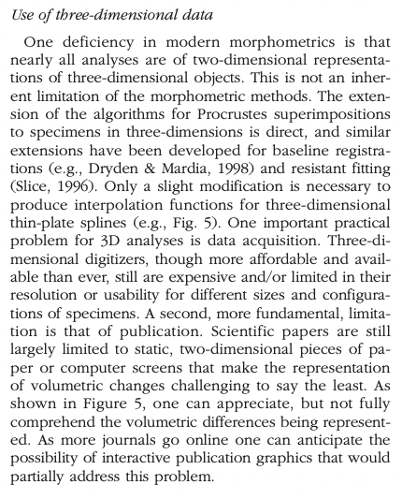
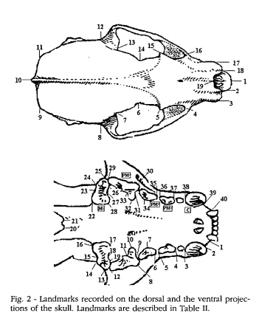
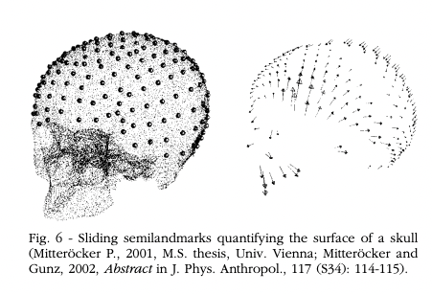
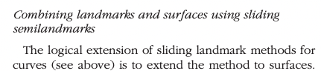
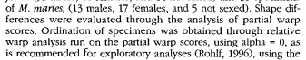
Examples from Italian Journal of Zoology, Volume 71, Issue 1 (2004) Proceedings of the Rome Geometric Morphometrics workshop

Slide 3
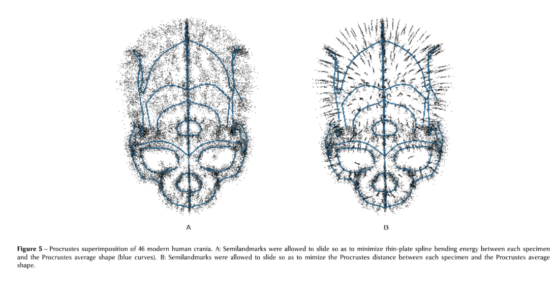
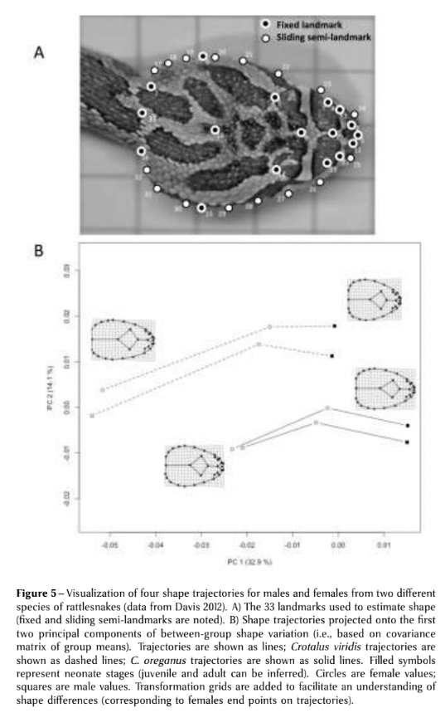
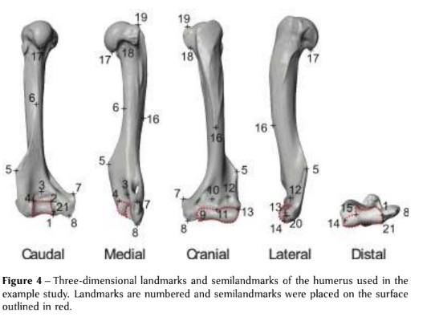
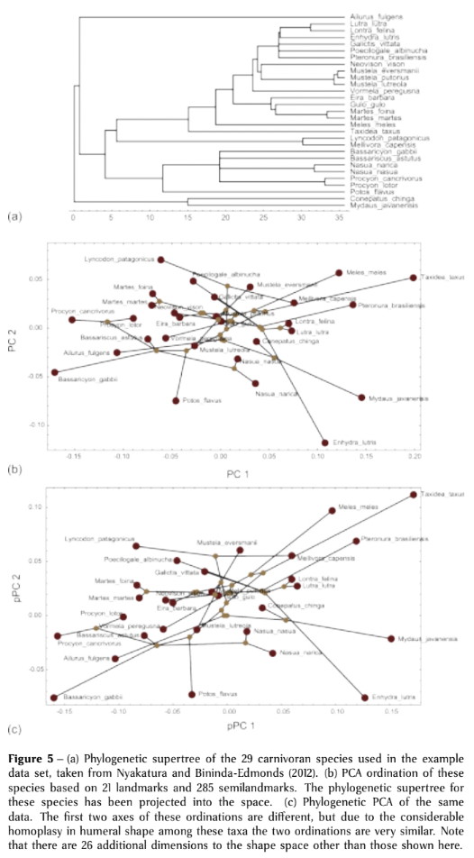
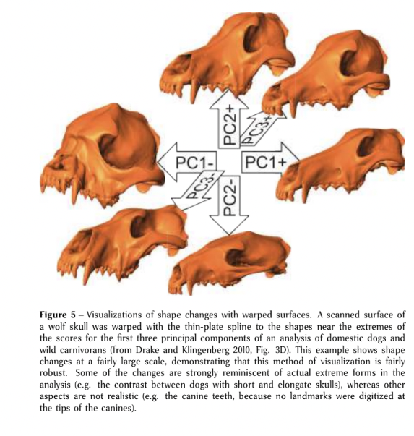
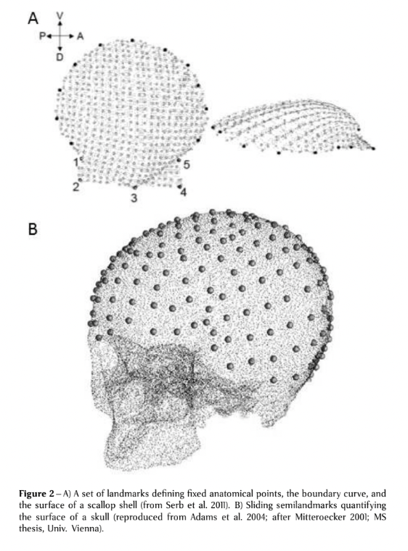
Examples from Italian Journal of Mammalogy, Volume 24, Issue 1 (2013) Virtual Morphology and Evolutionary Morphometrics in the new millennium..

Slide 4
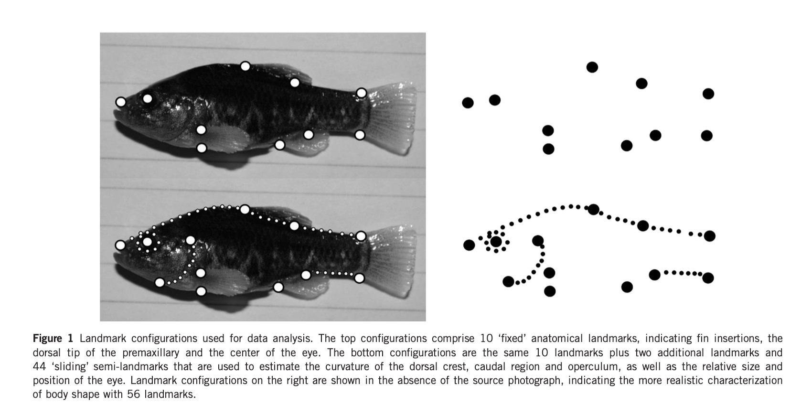
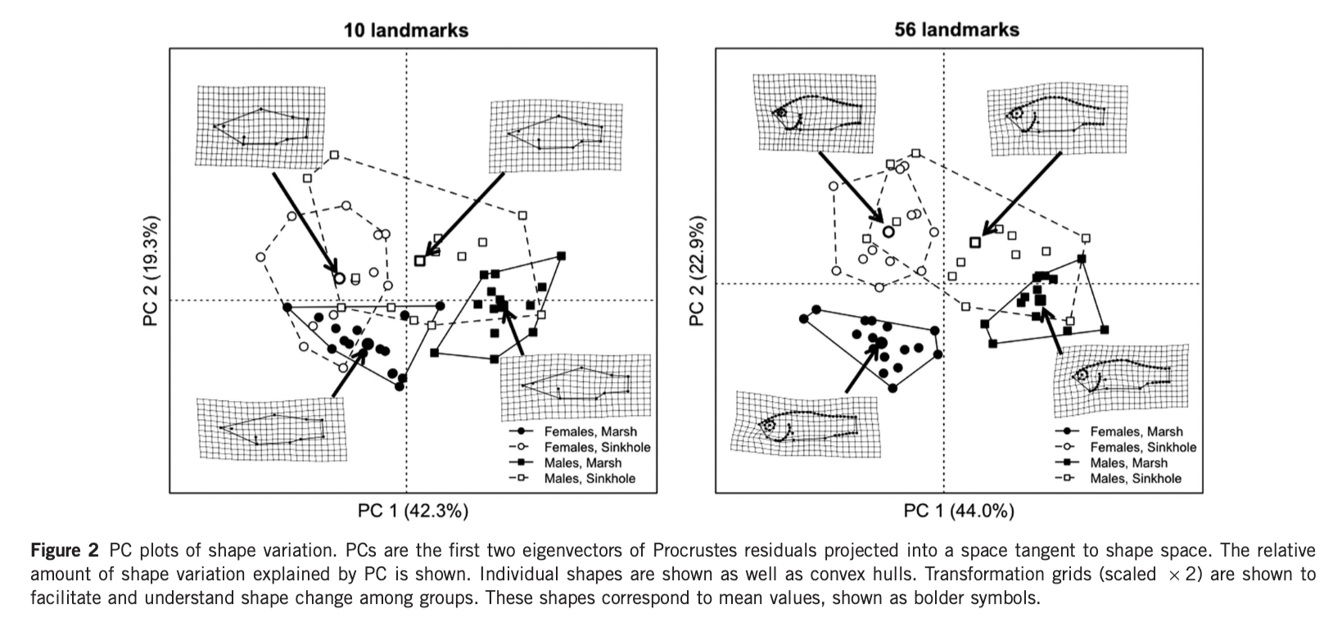
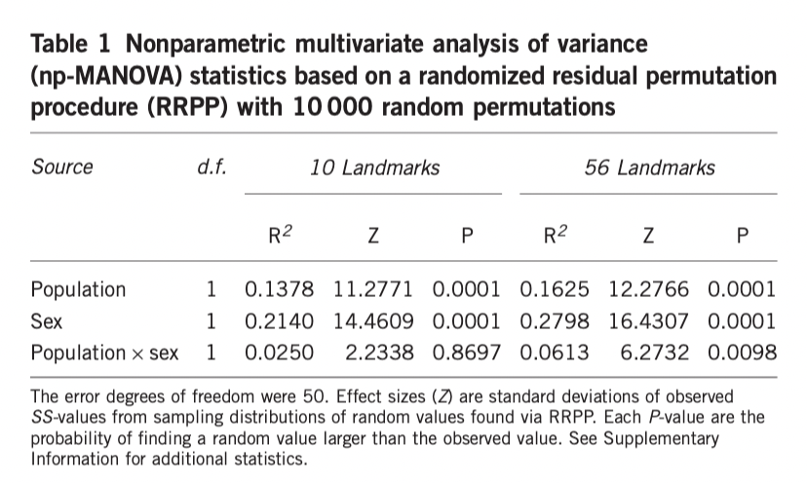
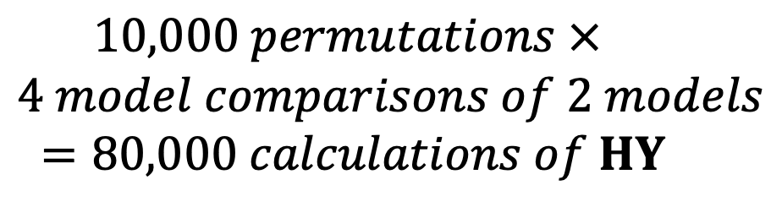
Randomization of residuals in a permutation procedure (RRPP)
$$10,000 permutations ×$$
$$4 model comparisons of 2 models$$
$$=80,000 calculations of HY$$
Collyer, M. L., Sekora, D. J., & Adams, D. C. (2015). A method for analysis of phenotypic change for phenotypes described by high-dimensional data. Heredity, 115(4), 357-365.

Slide 5
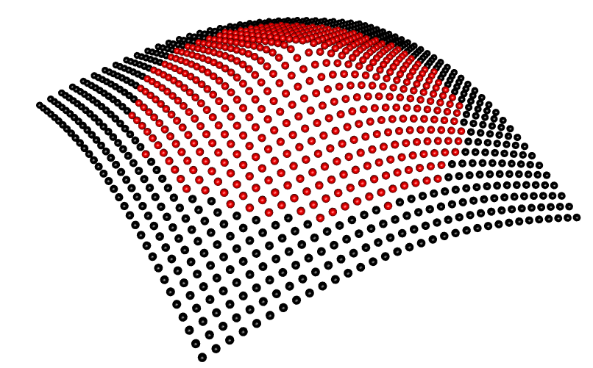

Slide 6
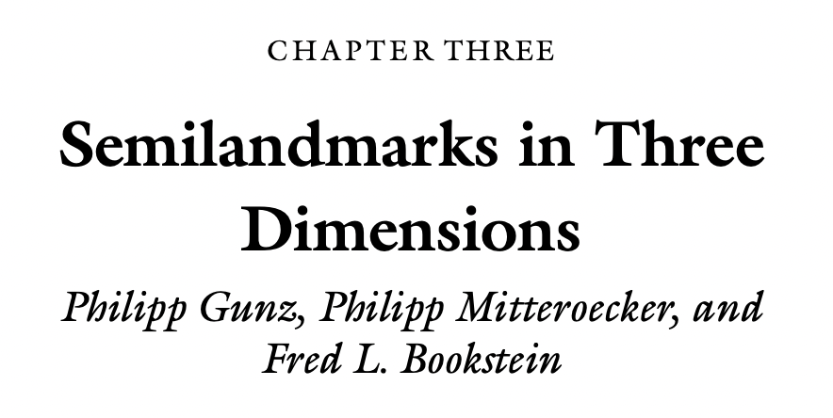
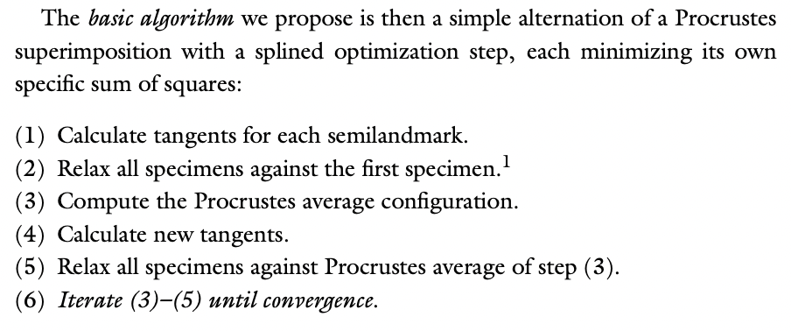
No definition of what convergence means
Implied that like GPA without sliding landmarks, variation among landmarks decreases monotonically?
What do programs do?
¯\_(ツ)_/¯
Gunz, P., Mitteroecker, P., & Bookstein, F. L. (2005). Semilandmarks in three dimensions. In Modern morphometrics in physical anthropology (pp. 73-98). Springer, Boston, MA.

Slide 7
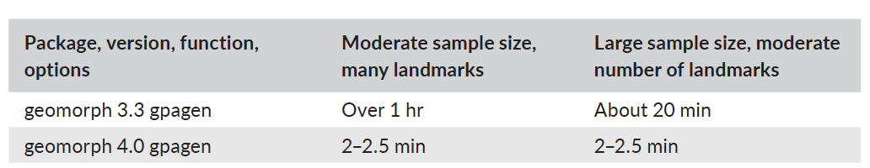
Wide data: 524 fixed LM, 500 semi-LM, 50 specimens
Long data: 20 fixed LM, 16 semi-LM, 5,000 specimens
Example template
Wide Long
Baken, E. K., M. L. Collyer, A. Kaliontzopoulou, & D. C. Adams. geomorph v4.0 and gmShiny: enhanced analytics and a new graphical interface for a comprehensive morphometric experience. Methods in Ecology and Evolution, 12 (12), 2355-2363.
geomorph 4.0 gpagen w/ PP 44s 113s
Morpho 2.8 slider3d w/ PP 76s 53 m

Slide 8
Wide data: 524 fixed LM, 500 semi-LM, 50 specimens
Long data: 20 fixed LM, 16 semi-LM, 5,000 specimens
Example template
Wide Long
Baken, E. K., M. L. Collyer, A. Kaliontzopoulou, & D. C. Adams. geomorph v4.0 and gmShiny: enhanced analytics and a new graphical interface for a comprehensive morphometric experience. Methods in Ecology and Evolution, 12 (12), 2355-2363.
geomorph 4.0 gpagen w/ PP 44s 113s
Morpho 2.8 slider3d w/ PP 76s 53 m
geomorph 4.0 gpagen app BE, w/PP 34s 28s

Slide 9
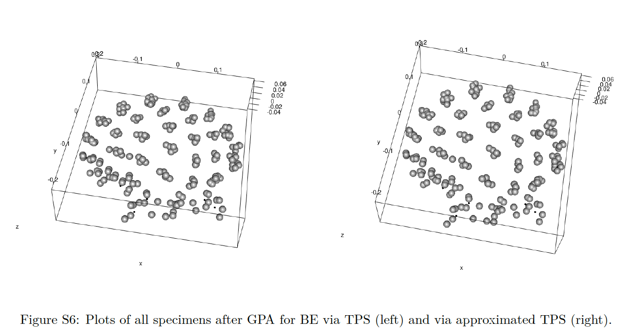
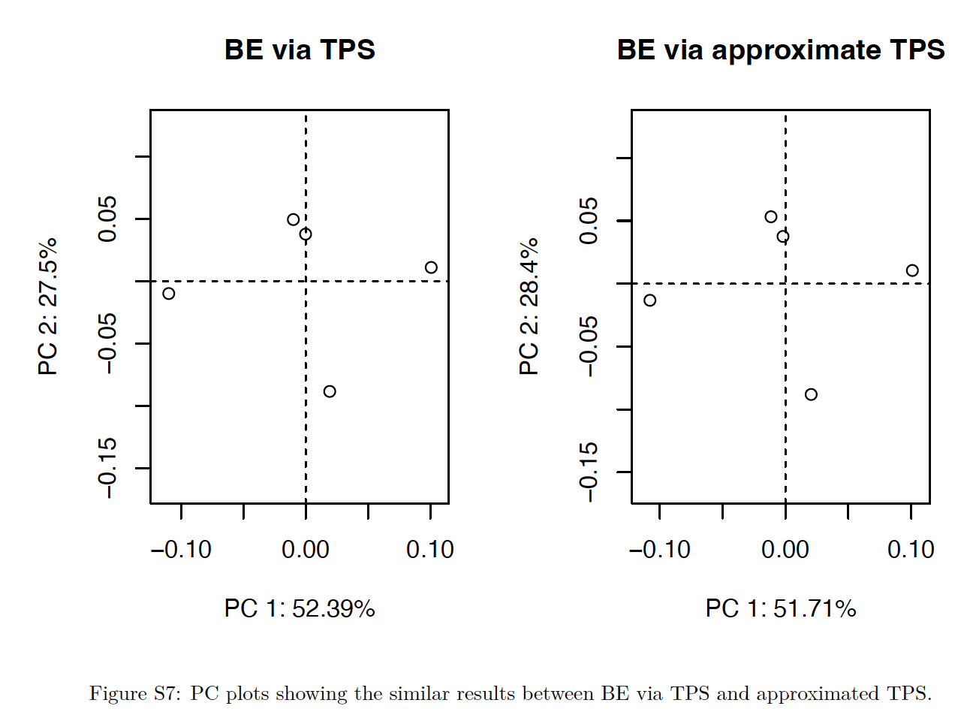
PCA on both data sets
Specimens following GPA
Baken, E. K., M. L. Collyer, A. Kaliontzopoulou, & D. C. Adams. geomorph v4.0 and gmShiny: enhanced analytics and a new graphical interface for a comprehensive morphometric experience. Methods in Ecology and Evolution, 12 (12), 2355-2363.

Slide 10
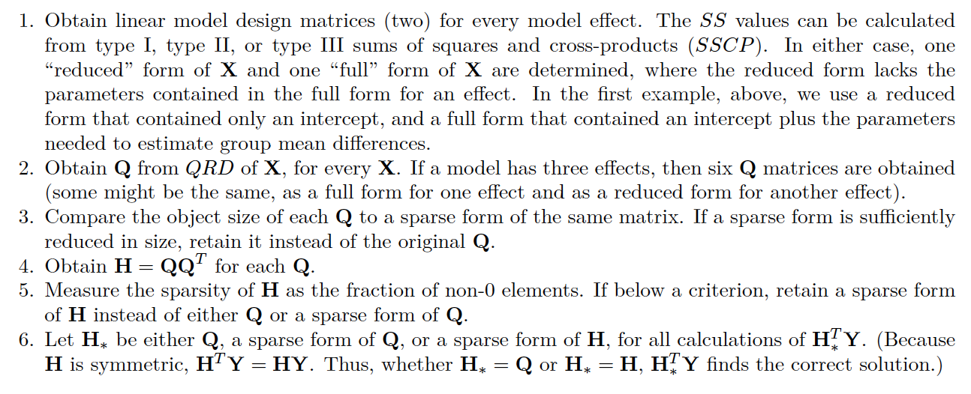
Baken, E. K., M. L. Collyer, A. Kaliontzopoulou, & D. C. Adams. geomorph v4.0 and gmShiny: enhanced analytics and a new graphical interface for a comprehensive morphometric experience. Methods in Ecology and Evolution, 12 (12), 2355-2363.

Slide 11
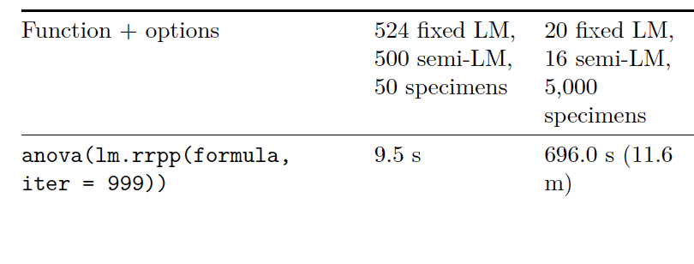
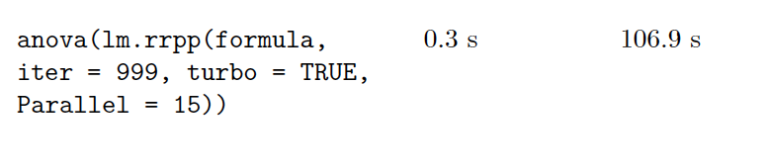
Before LMC
After LMC
This is a gross generalization – see below for more details – but the principle is sound!
Baken, E. K., M. L. Collyer, A. Kaliontzopoulou, & D. C. Adams. geomorph v4.0 and gmShiny: enhanced analytics and a new graphical interface for a comprehensive morphometric experience. Methods in Ecology and Evolution, 12 (12), 2355-2363.

Slide 12
